Slide 1
British Airways
Predictive model and its results
2022-11-09

Slide 2
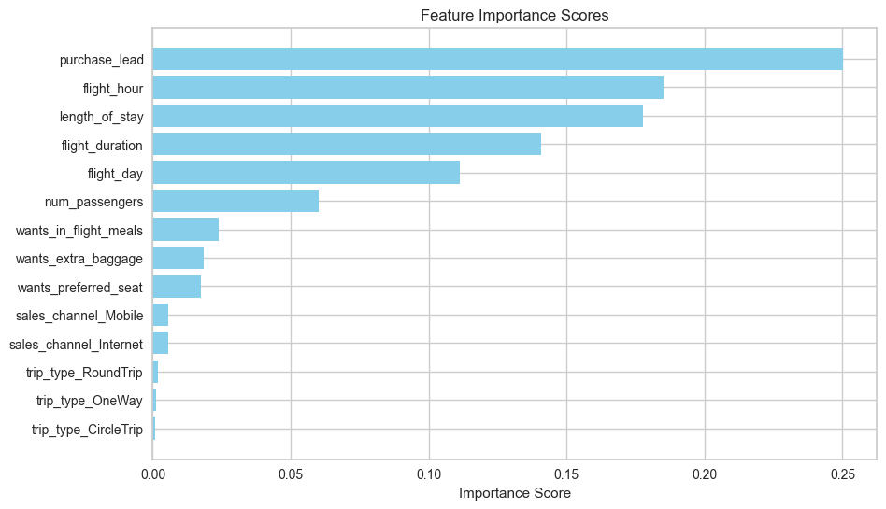
Predictive modelling results
Recall Rate
62.61%
Precision
62.60%
Accuracy
62.61%
Chance of predicting true successful bookings.
Will be predicted as actually completed bookings out of all successfully completed bookings.
Chance of predicting true successful bookings.
We are concerned with not predicting the successful bookings correctly. Imbalance dataset drives higher accuracy but it does not accurately predict the successful bookings. Dataset was balanced by performing undersampling of not booked class.
Top features that can drive successful flight bookings.

